Slide 1

Notes:
Well, this particular picture has nothing do with my presentation. This was just another Clickbait to grab your attention. Now that I have your complete attention, let's move onto the actual topic.

Slide 2

Web app security testing with browsers
Notes:
The title for today's presentation is 'Web app security testing with browsers'.

Slide 3
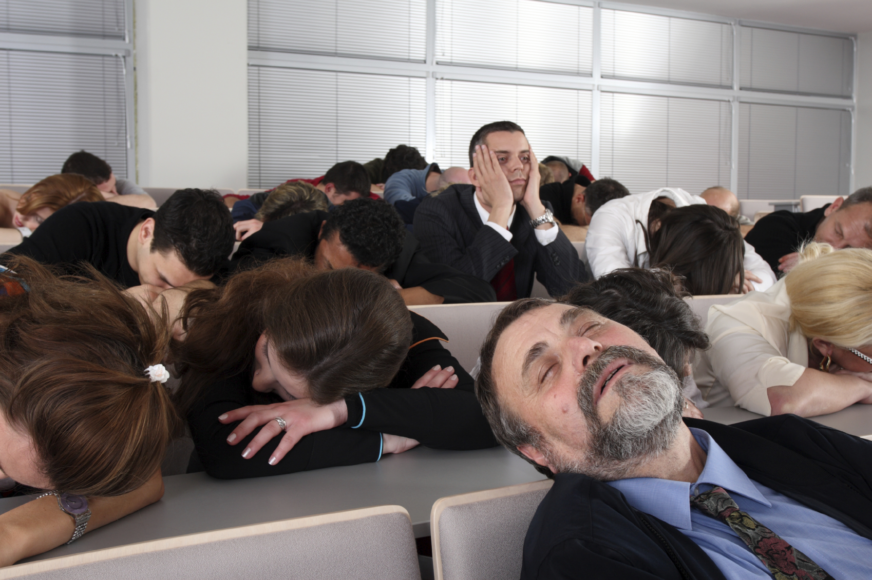
Who am I?
You really don’t care
You already decided to be in the room
Notes:
Usually, on this slide people talk about who they are. Where do they work, what are their accomplishments etc. But now that I see that you don't care and you have already decided to be in the room, I will skip that part.

Slide 4

This is NOT: a talk about 0 day a talk about next big thing in info sec a tool release
This is about:
a very small web app sec initiative
exploits you have heard for last few years
an idea and platform where you can pitch in
Notes:
This talk is not about a zero-day, it's not about the next big thing or breakthrough in infosec. It's also not a tool release.
However, this talk is about a small web application security initiative. In the following slides, you are going to hear about vulnerabilities and exploits that were here for past few years. On the bright side, this initiative is trying to close a major gap in web application security field and is a platform where you can also pitch in and help.

Slide 5

Technology has changed our lives
Notes:
Technology has changed our lives. There is no doubt about that. Let it be the wheel, car, train, airplane, medicines, pencil, pen or the chair you are sitting on, technology has helped us make our everyday life easier than before.

Slide 6
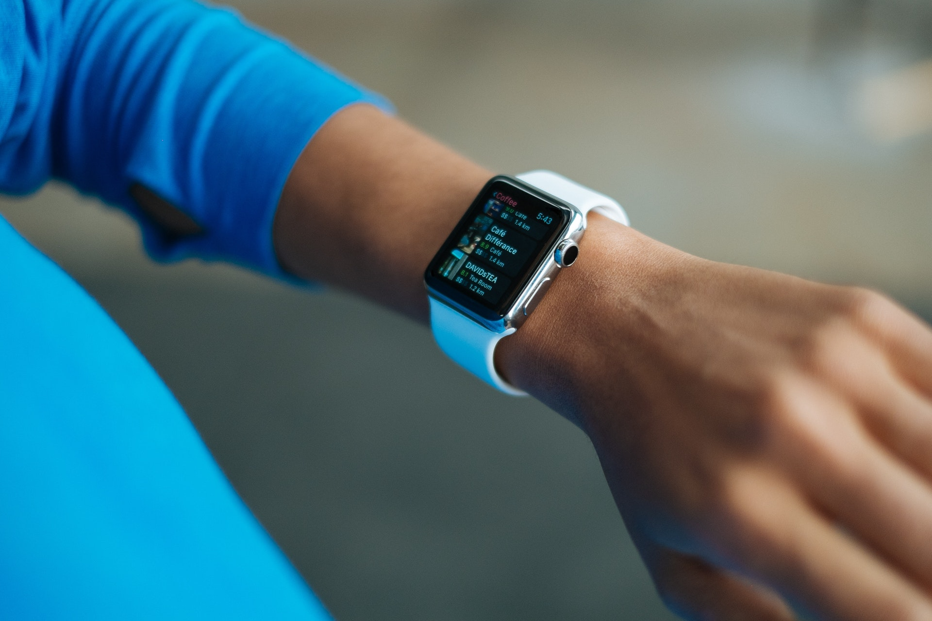
1998 and 2018
 | 1998 | 2018
Computers | Rare | Everywhere
Cell phones | Very rare | We have more than one
Internet | Rare and slow | Everywhere and fast
Notes:
This is a comparison between 20 years ago and today. The year 1998 was when Google was founded. In 1998, computers were rare, cell phones were, well, very rare. Internet was slow. I remember going to Internet cafe and paying per minute for browsing the Internet. A website with more than a dozen picture used to take forever to load. I remember web developers splicing images into several pieces so that they can make an impression of the website being loaded faster.

Slide 7
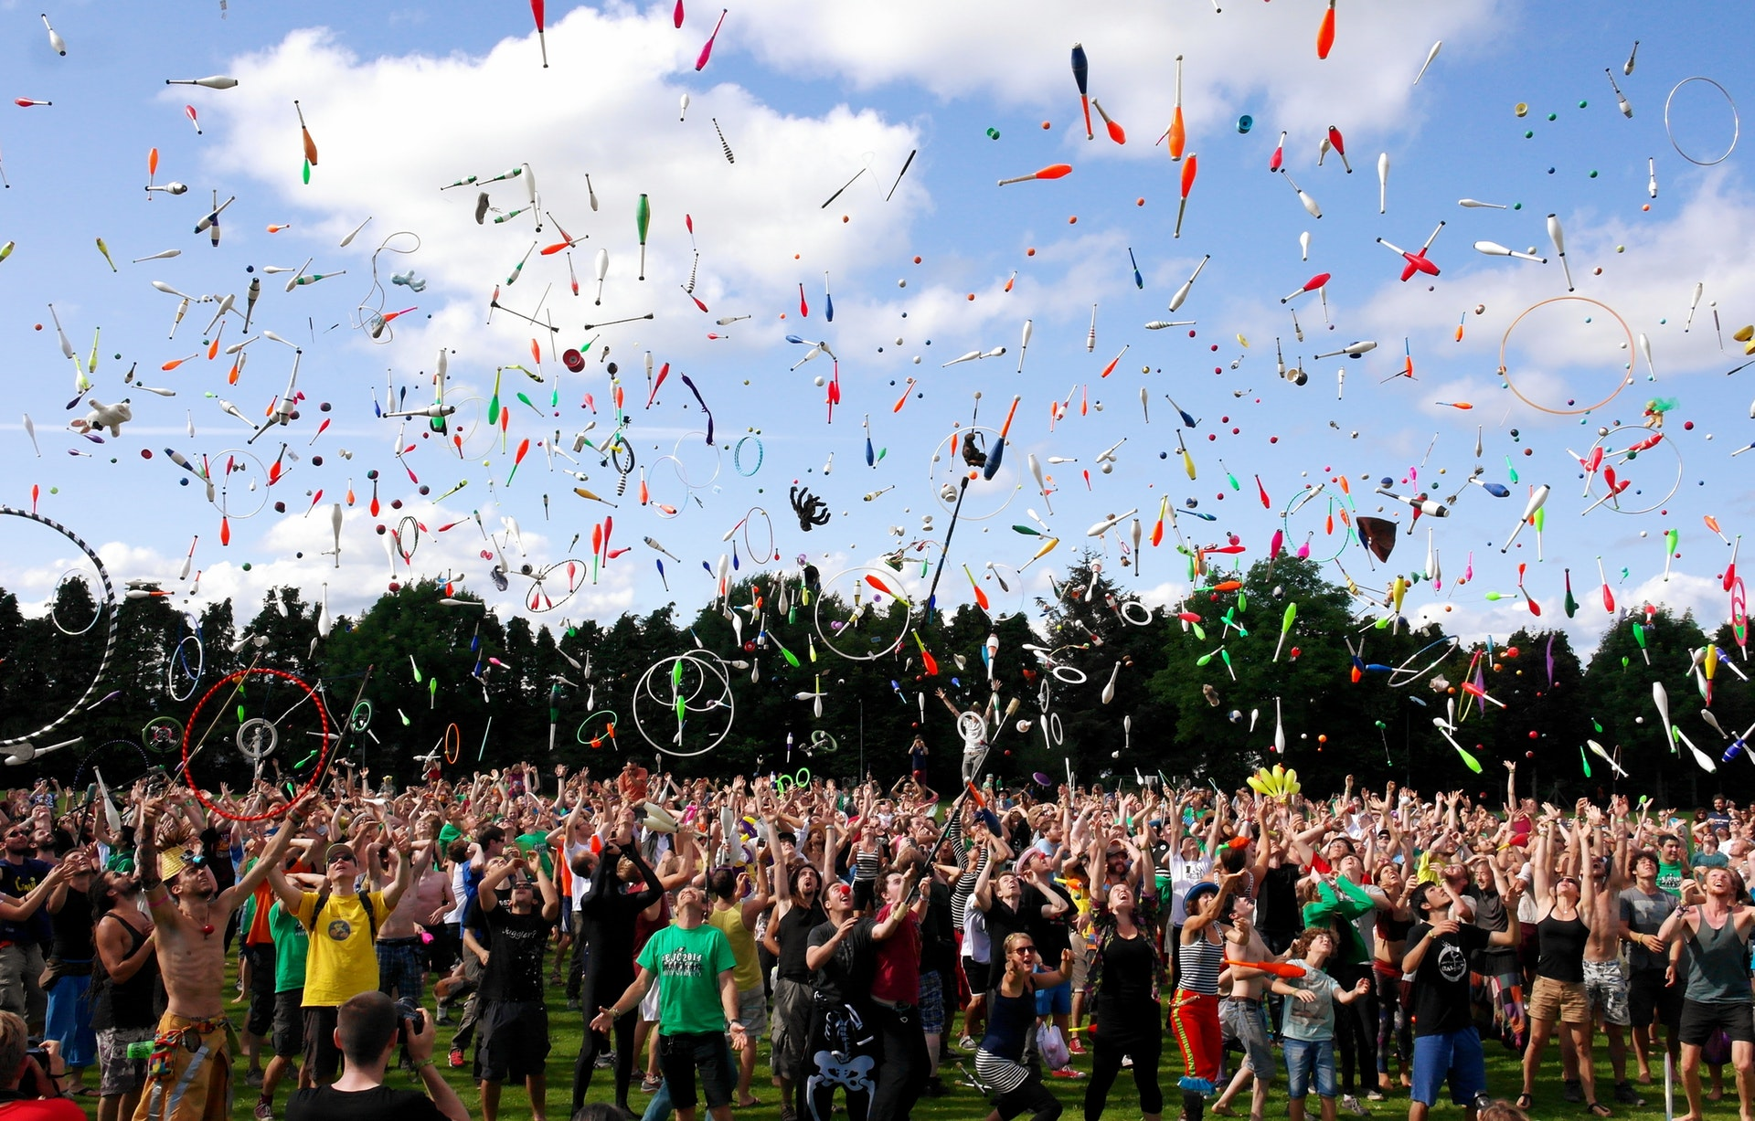
As of 2015, the number of internet users worldwide = 3.2 billion Source: http://time.com/money/3896219/internet-users-worldwide/
Notes:
According to a study in 2015, there are 3.2 billion Internet users.

Slide 8

Either you can communicate with 3.2 billion users or they can communicate with you.
Notes:
That means the moment you connect to the Internet, you can communicate with 3.2 billion users or they can communicate with you.

Slide 9

What if 1% of 3.2 Billion users tries to connect to your computer

Slide 10

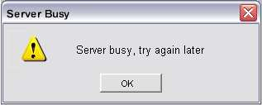
What if 1% of 3.2 Billion users tries to connect to your computer
Notes:
Most web services out there can handle this much data but most probably your cell phones and smart wacthes can't handle these requests and often times you heard about denial of service and distributed denial of service attacks.

Slide 11
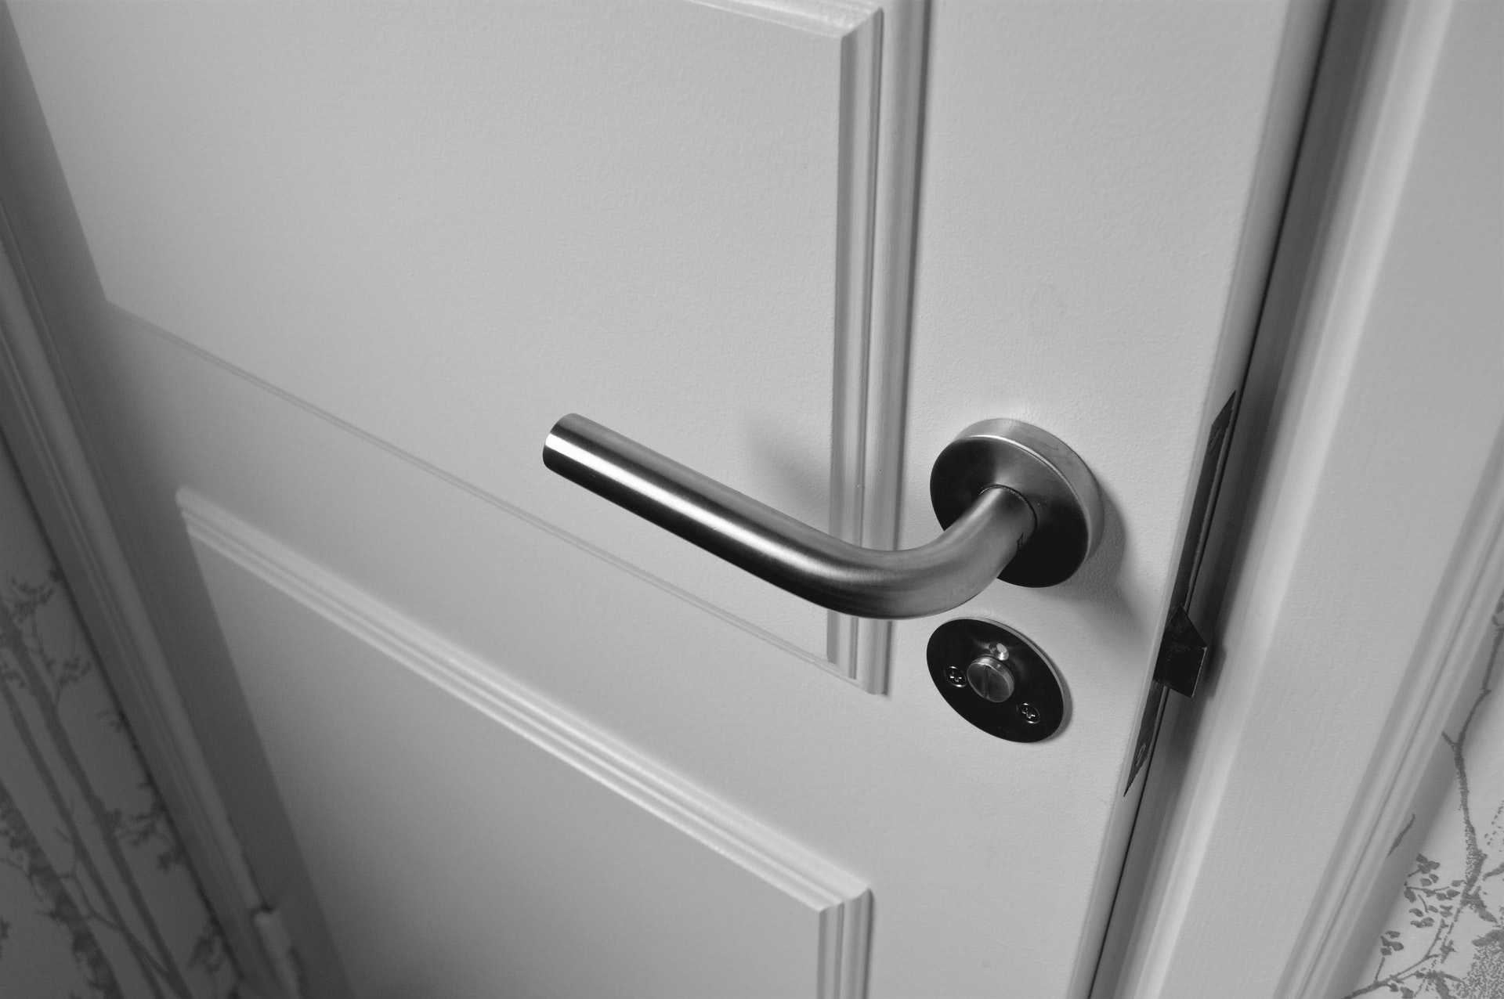
Some may knock on your door
Closed – fine
Not closed – not fine
Notes:
Let's keep denial of service attacks aside. Out of this 3.2 billion users, some of them will knock on your door or will try to get into your machine. If the door is locked, fine. If it is not locked, well, then it's not fine.

Slide 12

Increase of bug bounty systems
We still hear:
XSS
Cookie flag issues
CSRF
Notes:
One of the interesting patterns here is that these services are not often protected from against basic security practices. Let it be cross-site scripting, clickjacking, cookie flag issues or CSRF. If you look closely at bug bounty programs, the majority of the security issues are well-known to the industry for past decade.

Slide 13
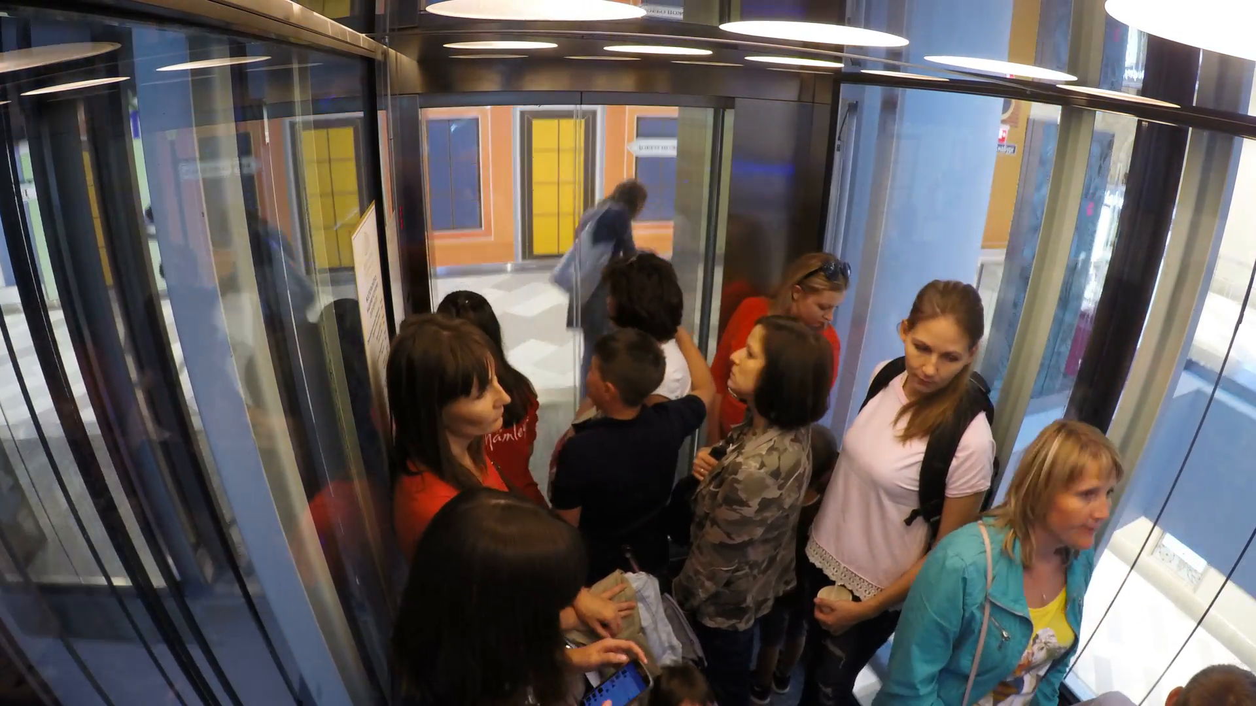
Notes:
Let's take this example. You are using the elevator in your office to get onto the floor you want. You are in the elevator and pressed the number you want. SUddenly you see that someone is walking towards the elevator and you want to stop the elevator for them. The immediate action from your side is to show your hand between the doors of the elevator. You have a trust that the elevator will not close the door as long as it detects some object between the doors.
However, can you expect the same level of minimum security from all the web applications out there? Even a decade after having proper solutions for xss and cookie flag attacks, we still those issues everywhere.

Slide 14

We still need to make things easy
Notes:
I believe one of the key issue here is because of a major gap between the developers and security professionals. We still need to make things easy for the developers. When making security testing reports, often times, in the reproduction steps and proof of concepts we are using Burp suite and OWASP ZAP to tell them how we found the security issue even though we are required to give steps for developers to reproduce the issue on their side. Most developers or mid level managers don't know how to use Burp suite or OWASP ZAP or they can't install these tools on their system.

Slide 15
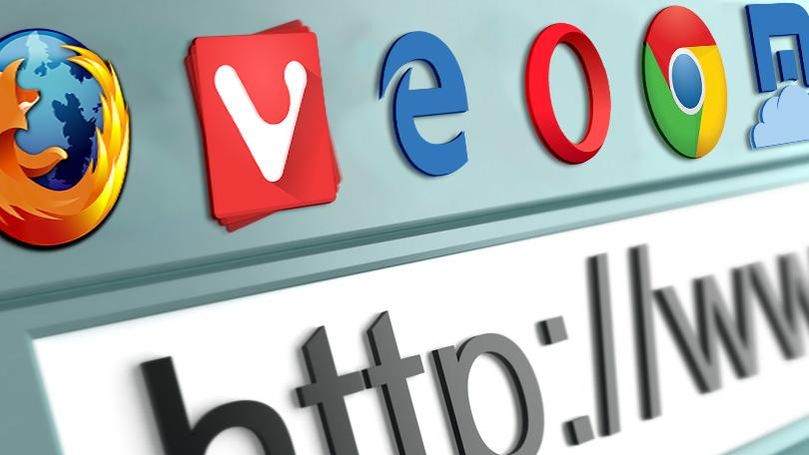
getmantra.com/wast

Slide 16

sechow.com/bricktown

Slide 17
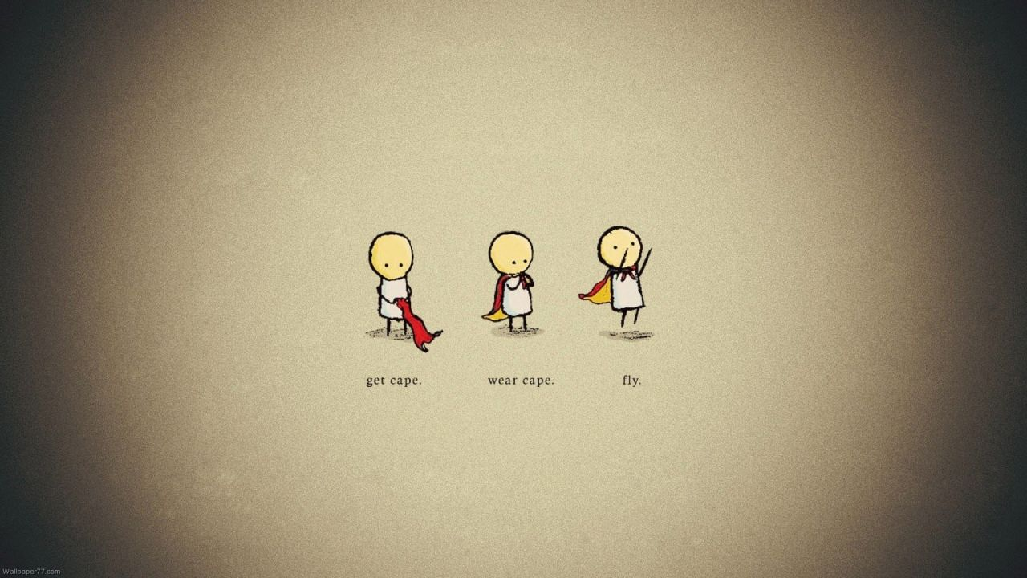
Simple, clean and friendly All levels can be solved using a browser Code can be reused to build CTFs Perfect for lab demos.

Slide 18


Slide 19

1. Help general audience learn web app security

Slide 20

2. Conduct basic CTFs in limited environments

Slide 21

3. For instant demo purposes

Slide 22

4. For justifying the likelihood

Slide 23
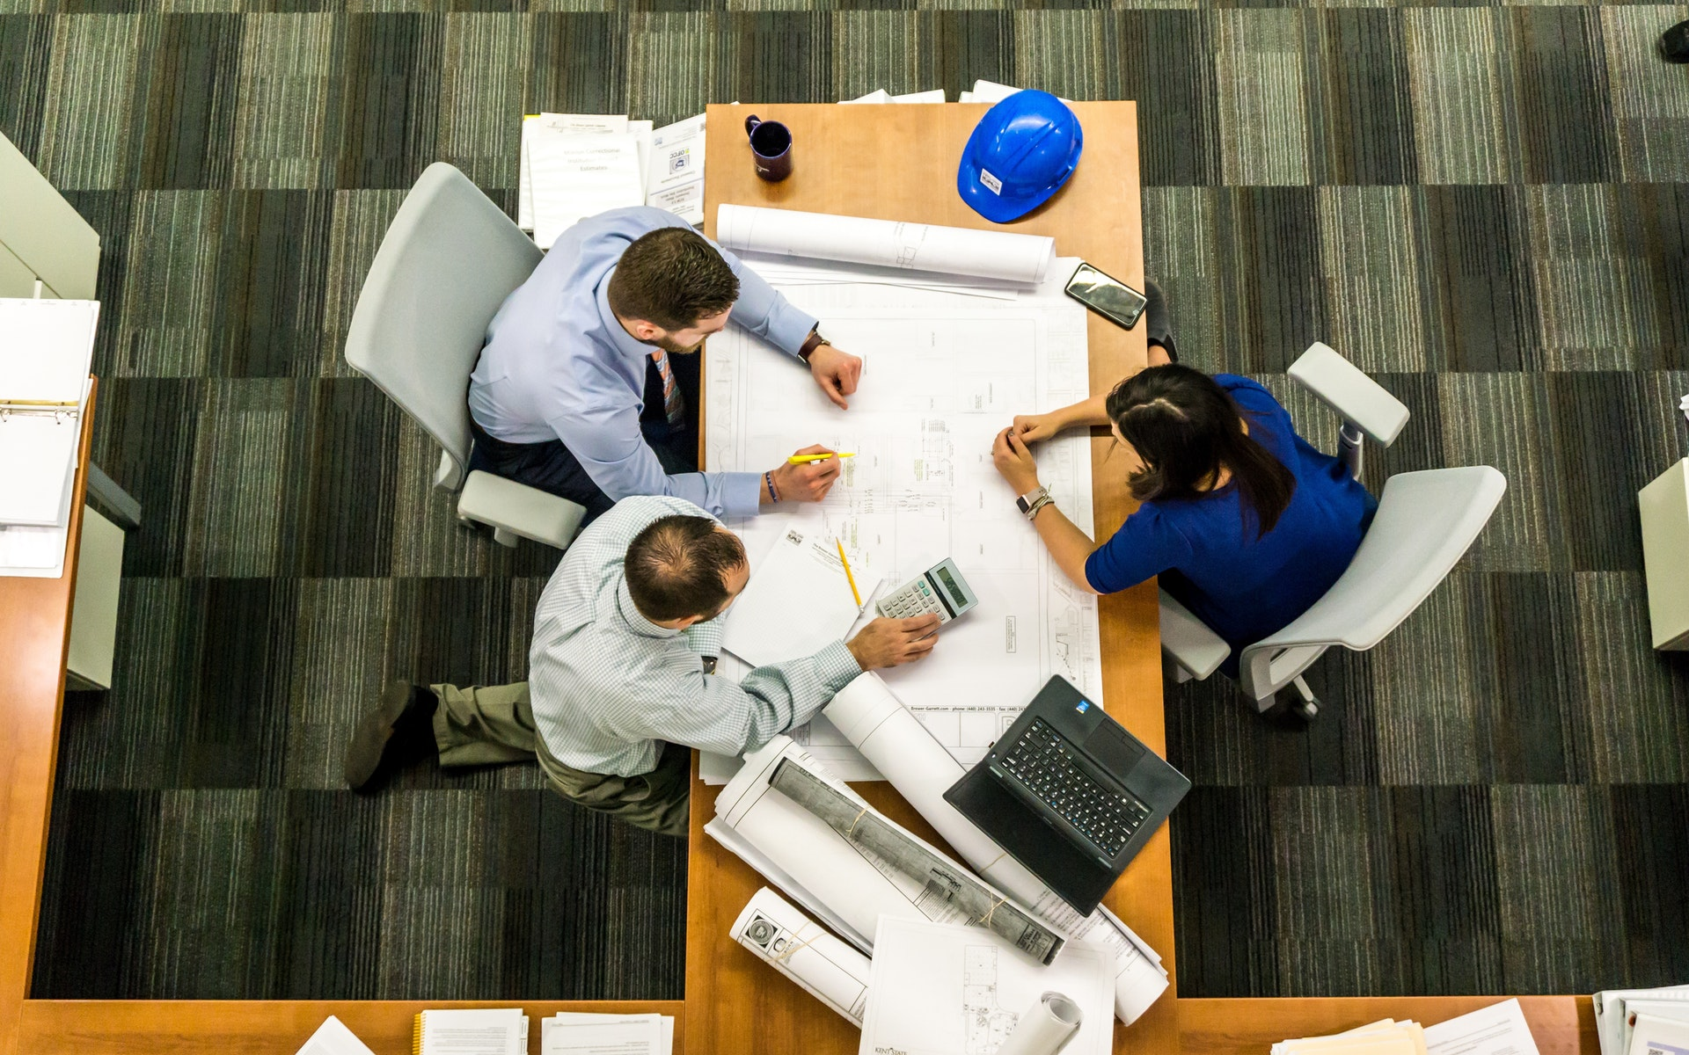
5. For writing better documentation

Slide 24

So long and thanks for all the attention ☺

Slide 25


My reaction when I saw the co-speakers and their topics

Slide 26


Expected outcome

Slide 27
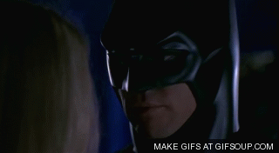
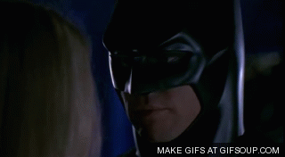
What others said

Slide 28
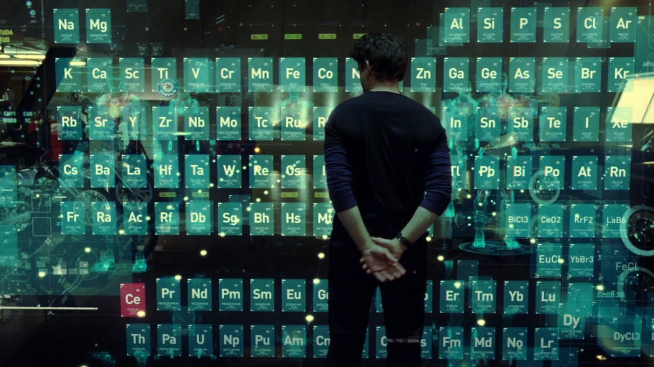
My name is Abhi M Balakrishnan I work for SD Elements by Security Compass

Slide 29
So long and thanks for all the attention ☺

